Slide 1

Control-of-flow statements
SQL Server BEGIN END:
The BEGIN...END statement is used to define a statement block. A statement block consists of a set of SQL statements that execute together. A statement block is also known as a batch.

Slide 2
In other words, if statements are sentences, the BEGIN...END statement allows you to define paragraphs.
The following illustrates the syntax of the BEGIN...END statement:

Slide 3
BEGIN
{ sql_statement | statement_block}
END

Slide 4
In this syntax, you place a set of SQL statements between the BEGIN and END keywords, for example:

Slide 5
BEGIN
SELECT product_id, product_name
FROM production.products
WHERE list_price > 100000;
IF @@ROWCOUNT = 0
PRINT 'No product with price greater than 100000 found';
END

Slide 6
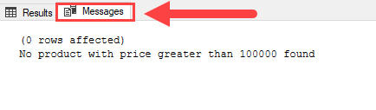
Note that the @@ROWCOUNT is a system variable that returns the number of rows affected by the last previous statement.

Slide 7
Nesting BEGIN... END:
The statement block can be nested. It simply means that you can place a BEGIN...END statement within another BEGIN... END statement.

Slide 8
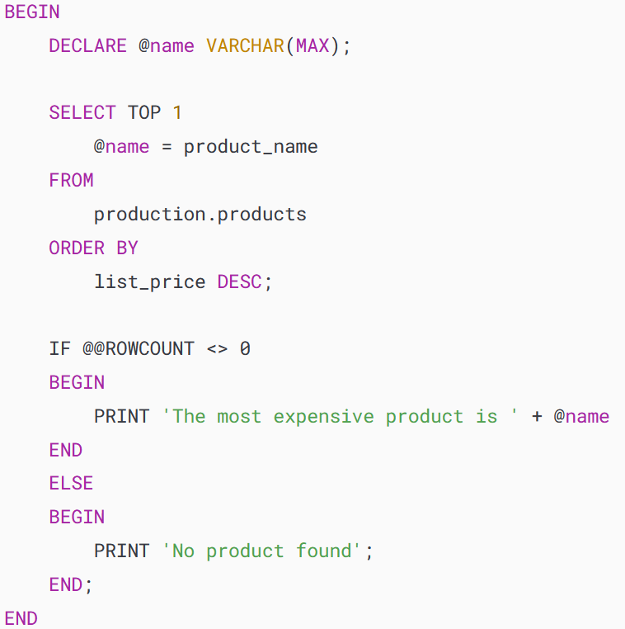

Slide 9
In this example, we used the BEGIN...END statement to wrap the whole statement block. Inside this block, we also used the BEGIN...END for the IF...ELSE statement.

Slide 10
SQL Server IF ELSE:
The IF...ELSE statement is a control-flow statement that allows you to execute or skip a statement block based on a specified condition.

Slide 11
The IF statement:
The following illustrates the syntax of the IF statement:
IF boolean_expression
BEGIN
{ statement_block }
END

Slide 12
In this syntax, if the Boolean_expression evaluates to TRUE then the statement_block in the BEGIN...END block is executed. Otherwise, the statement_block is skipped and the control of the program is passed to the statement after the END keyword.

Slide 13
Note that if the Boolean expression contains a SELECT statement, you must enclose the SELECT statement in parentheses.

Slide 14
The following example first gets the sales amount from the sales.order_items table in the sample database and then prints out a message if the sales amount is greater than 1 million.

Slide 15
BEGIN
DECLARE @sales INT;
SELECT @sales = SUM(list_price * quantity)
FROM sales.order_items i
INNER JOIN sales.orders o ON o.order_id = i.order_id

Slide 16
WHERE
YEAR(order_date) = 2018;
SELECT @sales;
IF @sales > 1000000
BEGIN
PRINT 'Great! The sales amount in 2018 is greater than 1,000,000';
END
END

Slide 17
The IF ELSE statement:
When the condition in the IF clause evaluates to FALSE and you want to execute another statement block, you can use the ELSE clause.
The following illustrates the IF ELSE statement:

Slide 18
IF Boolean_expression
BEGIN
-- Statement block executes when the Boolean expression is TRUE
END
ELSE
BEGIN
-- Statement block executes when the Boolean expression is FALSE
END

Slide 19
Each IF statement has a condition. If the condition evaluates to TRUE then the statement block in the IF clause is executed. If the condition is FALSE, then the code block in the ELSE clause is executed.

Slide 20
See the following example:
BEGIN
DECLARE @sales INT;
SELECT
@sales = SUM(list_price * quantity)
FROM sales.order_items i
INNER JOIN sales.orders o ON o.order_id = i.order_id

Slide 21
WHERE YEAR(order_date) = 2017;
SELECT @sales;
IF @sales > 10000000
BEGIN
PRINT 'Great! The sales amount in 2018 is greater than 10,000,000';
END

Slide 22
ELSE
BEGIN
PRINT 'Sales amount in 2017 did not reach 10,000,000';
END
END

Slide 23
Nested IF...ELSE:
SQL Server allows you to nest an IF...ELSE statement within inside another IF...ELSE statement, see the following example:

Slide 24
BEGIN
DECLARE @x INT = 10, @y INT = 20;
IF (@x > 0)
BEGIN
IF (@x < @y)
PRINT 'x > 0 and x < y';
ELSE
PRINT 'x > 0 and x >= y';
END
END

Slide 25
Handling Exceptions
SQL Server TRY CATCH :
The TRY CATCH construct allows you to gracefully handle exceptions in SQL Server.
The following illustrates a complete TRY CATCH construct:

Slide 26
BEGIN TRY
-- statements that may cause exceptions
END TRY
BEGIN CATCH
-- statements that handle exception
END CATCH

Slide 27
The CATCH block functions:
Inside the CATCH block, you can use the following functions to get the detailed information on the error that occurred:

Slide 28
ERROR_LINE() returns the line number on which the exception occurred.
ERROR_MESSAGE() returns the complete text of the generated error message.

Slide 29
ERROR_PROCEDURE() returns the name of the stored procedure or trigger where the error occurred.
ERROR_NUMBER() returns the number of the error that occurred.
ERROR_SEVERITY() returns the severity level of the error that occurred.

Slide 30
ERROR_STATE() returns the state number of the error that occurred.
Note that you only use these functions in the CATCH block. If you use them outside of the CATCH block, all of these functions will return NULL.

Slide 31
SQL Server TRY CATCH examples:
CREATE PROC usp_divide(@a decimal,
@b decimal, @c decimal output)
AS

Slide 32
BEGIN
BEGIN TRY
SET @c = @a / @b;
END TRY
BEGIN CATCH

Slide 33
SELECT
ERROR_NUMBER() AS ErrorNumber
,ERROR_SEVERITY() AS ErrorSeverity
,ERROR_STATE() AS ErrorState
,ERROR_PROCEDURE() AS ErrorProcedure

Slide 34
,ERROR_LINE() AS ErrorLine
,ERROR_MESSAGE() AS ErrorMessage;
END CATCH
END;

Slide 35
Call :
DECLARE @r decimal;
EXEC usp_divide 10, 2, @r output;
PRINT @r;

Slide 36
Thanks

Slide 37
Exercise

